Slide 1
Skillful Precipitation Nowcasting using Deep Generative Models of Radar
Precipitation Nowcasting
Multi-resolution Multi-scale Data (US)
Additional data sources
Baseline: PYSTEPS
Baseline: Extending Optical Flow with PWC-Nets
Baseline: UNet (regression and classification)
Baseline: Axial Attention (MetNet) classification
(Crude and toy) analogy to autoregressive language model
Beware of simplistic modeling assumptions in the loss!
A Thought Experiment
Generative Adversarial Networks
Nowcasting model: conceptual diagram
Quantitative Verification and its Limits
Evaluating GAN results
ТР Critical Success Index (CSI)
Power Spectral Density (PSD)
Continuous Ranked Probability Score (CRPS)
Intercomparison case study
Ablation analysis

Slide 2
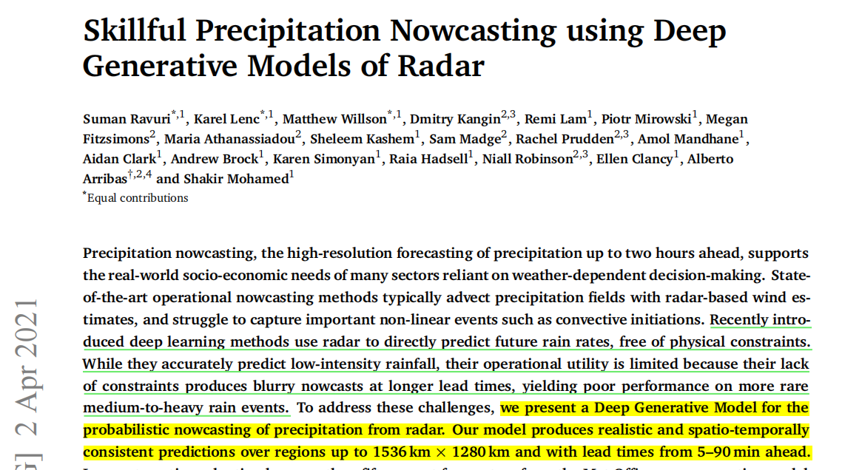
In this work, they demonstrate that improving the skill of probabilistic precipitation nowcasting
improves the value of precipitation nowcasts. To create these more skillful predictions, they develop
an observations-driven approach for probabilistic nowcasting using Deep Generative Models (DGMs).
DGMs are statistical models that learn probability distributions of data, and allow for easy generation
of samples from their learned distributions.

Slide 3
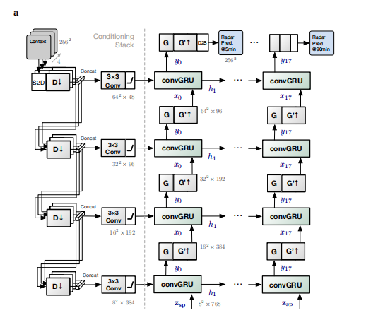
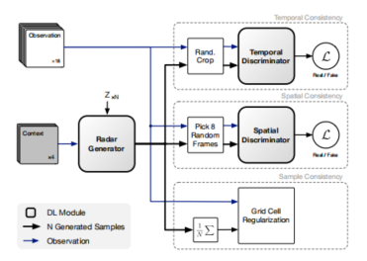
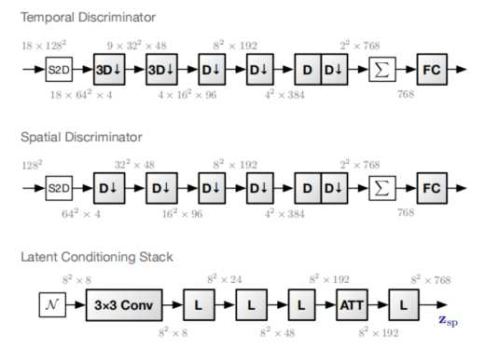
Model and Architecture

Slide 4
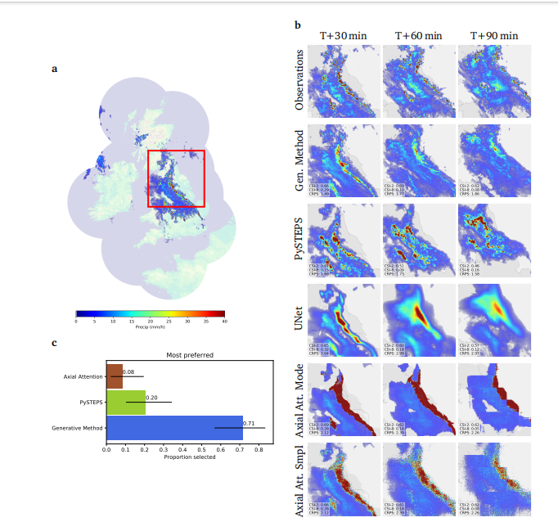
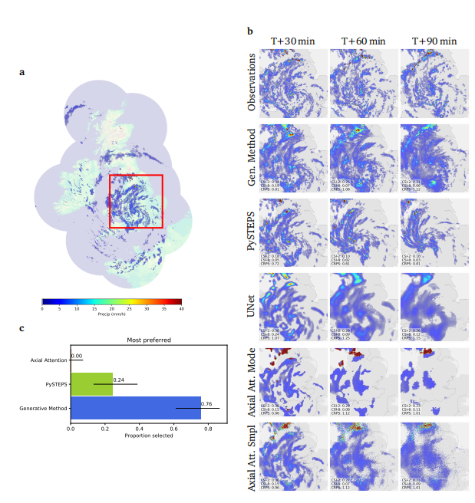
Case study of performance on a challenging precipitation

Slide 5
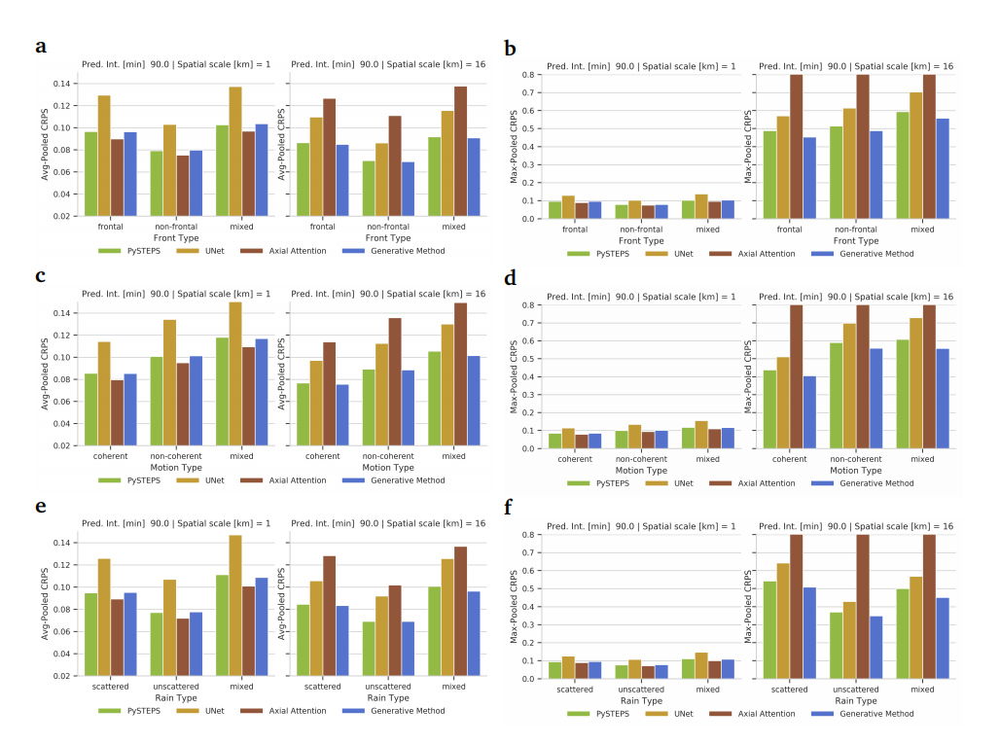
Rain-type analysis for predictions T+90 min lead time

